Slide 1
Steps in Program Development
Introduction to VBA

Slide 2
Data and Information
Data are raw facts
Examples of data include transactions, dates, amounts, etc.
Information are data that have been processed into a usable form
Information includes tables, documents, charts, etc.
Goal of computer applications is to process data into information

Slide 3
Six Basic Computer Operations
1. A computer can receive (input) data
2. A computer can store data in memory
3. A computer can perform arithmetic and manipulate text strings
4. A computer can compare the contents of two memory locations and select one of two alternatives
5. A computer can repeat a group of operations
6. A computer can output information (processed data)
We will use pseudocode statements to demonstrate these six operations.

Slide 4
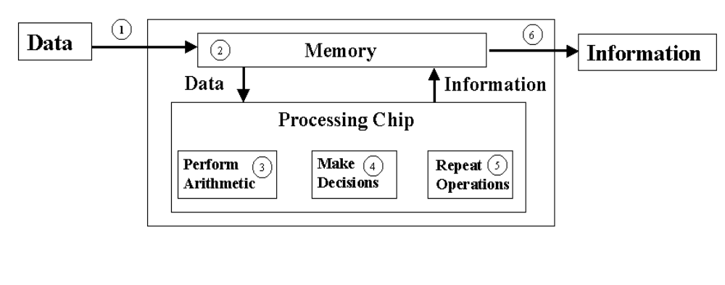
Computer Operations

Slide 5
Programs and Programming
A program is a very specific set of rules that tell the computer which switches should be "ON" or "OFF".
The process of creating a program is called programming.
The computer only knows what it is told through programs, so they must be accurate and very specific.

Slide 6
What is Programming?
Deciding if there is a task to be accomplished or problem to be solved using a computer, e.g., is there a need for a program?
Determining the nature of the task or problem, e.g., what must the program do?
Developing a plan that will accomplish the task or solve the problem, e.g., generating the step-by-step process that the program will follow (algorithm).
Converting the plan into a computer language program
Testing the program to ensure it accomplishes task or solves problem defined earlier.
Implementing the program to accomplish the task or solve the problem.

Slide 7
Types of Computer Languages
Procedural: Monolithic programs that run from start to finish with no intervention from user other than input
Basic, QBasic, QuickBasic
COBOL
FORTRAN
C
Object Oriented/Event Driven (OOED): Programs that use objects which respond to events; use small segments to code for each object
      JAVA
Visual Basic
      Visual Basic for Applications (VBA)
Visual C++

Slide 8
Levels of Computer Languages
Low Level: at the level of the computer, i.e., in binary (0-1) format Computer can only execute a binary form of a program
Intermediate Level: close to the computer but uses English words or mnemonics, e.g., Assembler, that is converted directly into binary
High Level: at the level of the programmer using English words and clearly defined syntax; must be converted or translated into binary for computer to implement it, e.g., VBA
Need a software program to handle the conversion of high-level into binary

Slide 9
Translating from High-level Language to Binary
Interpreted: each statement translated as it is executed--slow but easy to use
Compiled: entire program is converted to binary--executes faster, but more difficult to use (.exe files are compiled programs)
VBA is interpreted during creation and testing but can then be compiled into an .exe file

Slide 10
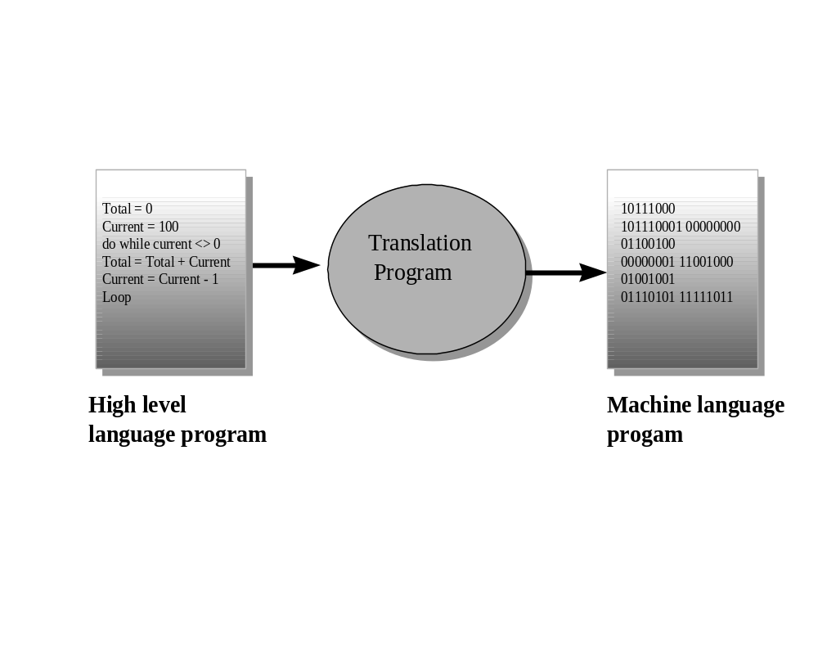

Slide 11
Steps in Program Development
Define the problem
  Inputs
  Outputs
  Processing steps to produce outputs
  Defining Diagram
Input | Processing | Output
Num-1 | Read 3 numbers | Total
Num-2 | Add numbers together
Num-3 | Print Total number

Slide 12
Outline Solution – rough draft
Major processing steps
Major subtasks (if any)
Major control structures (repetition loops, branches etc)
Major variables & record structures
Main logic

Slide 13
Develop Outline into Algorithm
Pseudocode (form of Structured English)
Nassi-Schneiderman diagram
Flowcharts for small parts of program

Slide 14
Test Algorithm for Correctness
Desk checking using test data
Code the Algorithm

Slide 15
Run Program on the Computer
Compile
Correct syntax errors
Run program with test data
Correct logic errors

Slide 16
Document and Maintain Program
On-going task
Comments within program – very important in Java
Structure charts
Solution Algorithm
Test data results
  Maintenance often done by other programmers. If program well designed, code will be easier to maintain

Slide 17
Introduction to Algorithms and Pseudocode
Algorithm –lists steps in accomplishing a task
  Lucid, precise, unambiguous
  Give correct solution in all cases
  Eventually end

Slide 18
Example of Algorithm
Turn on calculator
Clear calculator
Repeat the following instructions
  Key in dollar amount
  Key in decimal point
  Key in cents amount
  Press addition key
Until all prices have been entered
Write down total price
Turn off calculator

Slide 19
Using Pseudocode
An important part of the developing the logic for action objects is generating corresponding pseudocode.
Pseudocode involves actually writing a program in English rather than in a computer language.
When the actual computer program is written, the pseudocode is translated into computer language.
A pseudocode program is useful for two reasons:
  The programmer may use it to structure the algorithm's logic in writing.
  It provides a relatively direct link between the algorithm and the computer program

Slide 20
What is Pseudocode?
Statements written in simple Englih
Each instruction written on separate line
Keywords and indentation are used to signify particular control structures
Groups of statements are formed into modules (later we will talk about Classes0

Slide 21
Program Data
Variables
  Name given to collection of memory cells designed to store a particular data item
  Variable because value stored in that variable may change as program executes

Slide 22
Program Data (continued)
Constant
  Data item with a name and a value that remain the same during program execution.
  The name Fifty may be given to a data item that will always contain the value 50

Slide 23
Program Data (continued)
Literal
  A constant whose name is the written representation of it’s value
  For example the program may contain the literal ’50’

Slide 24
Program Data (continued)
Elementary Data item
  One containing a single variable that is always treated as a unit
  These are classified into data types
  A data type consists of a set of data values and a set of operations that can be performed on those values
    Integer, string and boolean, double re examples
    We will talk more about this later

Slide 25
Program Data (continued)
Data Structures
  An aggregate of other data items
  Data is grouped together in a particular way
  Record- a collection of data items or fields hat bear some relationship to each other. For example a student record may contain student number, name address, etc

Slide 26
Program Data (continued)
Data Structures (continued)
  Record- a collection of data items or fields hat bear some relationship to each other. For example a student record may contain student number, name address, etc
  File – a collection of records. For example a student file may contain a collection of student records

Slide 27
Program Data (continued)
Data Structures (continued)
  Array – made up of a number of variables or data items that all have the same data type and are accessed by the same name. For example an array called scores may contain a collection of students’ exam scores. Access to the individual items is made by the use of an index or subscript beside the name of the array i.e. Scores(3)

Slide 28
Program Data (continued)
Data Structures (continued)
  String – a collection of characters. For example, the string “Jenny Parker” may represent a student’s name

Slide 29
How to Write Pseudocode
Pseudocode allows the programmer to design an algorithm to solve a computing problem without having to be concerned with the syntax of the programming language (Java)

Slide 30
Six Basic Computer Operations
A computer can receive information
  Read student name
  Get system date
  Read number_1, number_2
  Get tax_code

Slide 31
Six Basic Computer Operations (cont)
A computer can output information
  Print ‘Program Completed’
  Write customer record to master file
  Put out name, address and postcode
  Output total_tax
  Display ‘End of data’

Slide 32
Six Basic Computer Operations (cont)
A computer can perform arithmetic
  Add number to total
  Total = total + number
+ Add
- Subtract
* Multiply
/ Divide
% Modulus
( ) Parentheses

Slide 33
Six Basic Computer Operations (cont)
A computer can assign a value to a variable or memory
To give data an initial value in pseudocode, the verbs Initialize or Set are used
To assign a value as a result of some processing, the symbol ‘=‘ is used
To keep a piece of information for later use, the verbs Save or Store are used
Examples
Initialize total accumulators to zero
Set student_count to 0
Total_price = cost_price + sales_tax
Store customer_num in last_customer_num

Slide 34
Six Basic Computer Operations (cont)
A computer can compare two variables and select one of two alternatives
  IF student is part_time THEN
    Add 1 to part_time_count
  ELSE
    Add 1 to full_time_count
  ENDIF

Slide 35
Six Basic Computer Operations (cont)
A computer can repeat a group of actions
  DOWHILE student_total <50
    Read student_record
    Print student_name, address to report
    Add 1 to student_total
  ENDDO
  WHILE student_total < 50 DO
    Read student_record
    Print student_name, address to report
    Add 1 to student_total
  ENDWHILE

Slide 36
The Structure Theorem
Three Basic Control Structures
Sequence
Selection
Repetition

Slide 37
Object-Oriented Event-driven Programming (OOED)
OOED uses objects, or self contained modules that combine data and program code which pass strictly defined messages to one another.
OOED is easier to work with, because it is more intuitive than traditional programming methods.
Visual Basic is an OOED language.
Users can combine the objects with relative ease to create new systems or extend existing ones.
Properties of objects are attributes associated with an object.
Methods of objects are those activities that the object can carry out.
Objects respond to events.

Slide 38
OOED Programming Process
A six step process for writing an OOED computer program:
1. Define problem.
2. Create interface
3. Develop logic for action objects
4. Write and test code for action objects
5. Test overall project
6. Document project in writing
No matter how well a program is written, the objective
is not achieved if the program solves the wrong problem.

Slide 39
Step One: Define Problem
Before you can create a computer application to solve a problem, you must first clearly define it.
This may involve a study of the problem to understand the inputs and outputs.
Must identify the data to be input to the program and the results to be output from it.
Sketching an interface is a good way to understand the problem and to communicate your understanding to other people.
Denote input and output objects as well as action objects--those for which code (instructions) are needed.

Slide 40
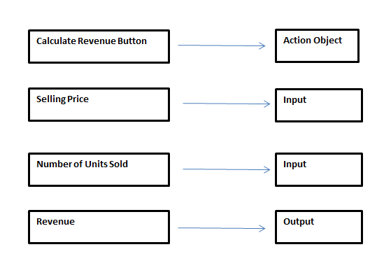
Sketch of Calculate Revenue Interface

Slide 41
Step Two: Create Interface
Once you have defined problem and sketched interface, you are ready to create interface.
Doing this with VBA is quite easy.
For our first program you only need four objects:
  button for action
  inputBox for input (Selling Price)
  inputBox for input (Units Sold)
  MessageBox for output

Slide 42
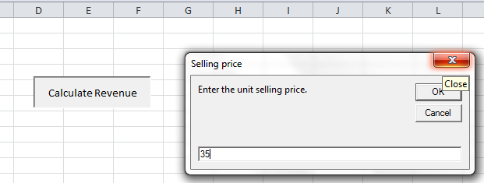
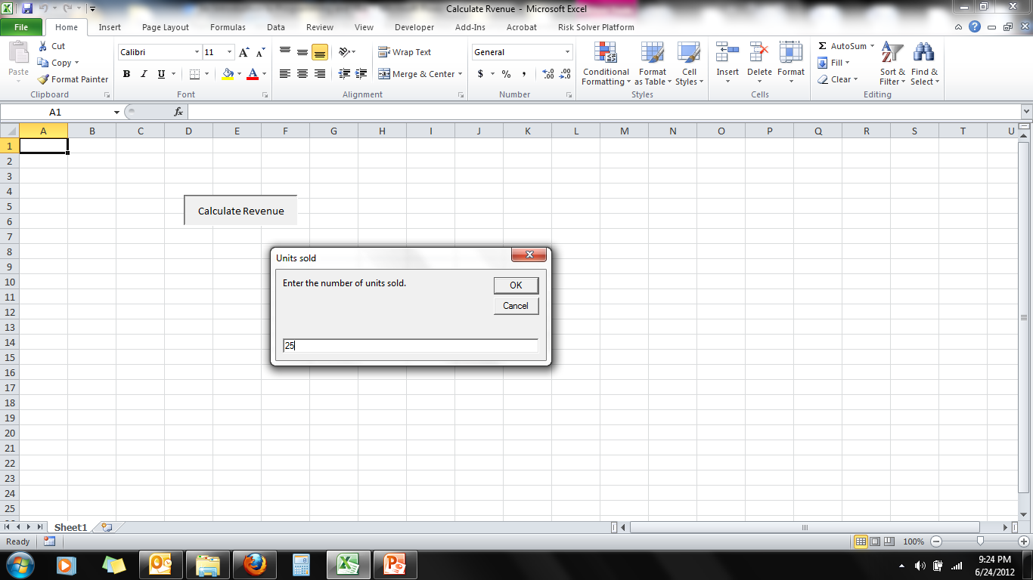
Calculate Revenue Interface - Input

Slide 43
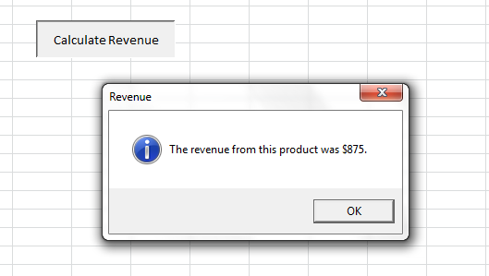
Calculate Revenue Interface - Output

Slide 44
Step Three: Develop Logic for Action Objects
Need to think about what each action object should do in response to an event
This is the logic for each object
Use Input/Processing/Output (IPO) Tables and Pseudocode to develop the logic
IPO Tables show the inputs, outputs, and the processing to convert inputs into outputs

Slide 45
IPO Table for Calculate Revnue Button
Input | Processing | Output
Unit Price Quantity Sold | revenue = unitPrice X quantitySold | Revenue

Slide 46
Pseudocode for Count High Values Button
Begin procedure
Input Selling Price
Input Quantity Sold
Revenue = Selling Price x Quantity Sold
Output Revenue
End procedure

Slide 47
Step Four: Write and Test Code of Action Objects
Once you learn the vocabulary and syntax of a language, you should be able to convert the logic embodied in the pseudocode into a computer language. In our case, we use VBA.
You need to test each code for each action object as they are created.
Once the object code is written, the programmer must test and correct it. This stage is referred to as debugging, since it involves removing "bugs".
Use test data for which you know the correct answer to test the object code.

Slide 48
VBA Code for Calculate Revenue Button
Sub CalculateRevenue()
Dim unitPrice As Currency
Dim quantitySold As Integer
Dim revenue As Currency
' Get the user's inputs, then calculate revenue.
unitPrice = InputBox("Enter the unit selling price.", "Selling price")
quantitySold = InputBox("Enter the number of units sold.", "Units sold")
revenue = unitPrice * quantitySold
' Report the results.
MsgBox "The revenue from this product was " & Format(revenue, "$#,##0") _
& ".", vbInformation, "Revenue"
End Sub

Slide 49
Step Five: Test Overall Project
Even with extensive testing, some bugs can often be found in most commercial software.
With computer software, each program instruction must be absolutely correct. Otherwise, the whole program might fail.
BE SURE to test your program in the actual environment and on the actual data on which it will be used (just ask IBM at the Olympics).

Slide 50
Step Six: Document Project in Writing
Documentation includes the pictorial and written descriptions of the software. It contains internal descriptions of programming commands and external descriptions and instructions.
Documentation is necessary since, sooner or later, the program will need to be maintained (correct bugs, add new features, handle problems not thought of previously, etc. This is NOT possible without documentation.
Written documentation includes books, manuals, and pamphlets that give instructions on software use and discuss the objectives and logic of the software.

Slide 51
Risks in Numerical Computing
Almost all computer calculations involve round off error (limited precision error)
If not monitored and planned for carefully, such errors can lead to unexpected and catastrophic results
  Ariane 5 Rocket Failure
  Patriot Missile Failure during Gulf War

Slide 52
The Explosion of the Ariane 5
On June 4, 1996 an unmanned Ariane 5 rocket launched by the European Space Agency exploded just forty seconds after its lift-off.
The rocket was on its first voyage, after a decade of development costing $7 billion. The destroyed rocket and its cargo were valued at $500 million.
It turned out that the cause of the failure was a software error in the inertial reference system. Specifically a 64 bit floating point number relating to the horizontal velocity of the rocket with respect to the platform was converted to a 16 bit signed integer. The number was larger than 32,767, the largest integer storeable in a 16 bit signed integer, and thus the conversion failed.
Back

Slide 53
Patriot Missile Failure during Gulf War
During the Gulf War, an American Patriot Missile battery in Saudi Arabia, failed to track and intercept an incoming Iraqi Scud missile. The Scud struck an American Army barracks, killing 28 soldiers and injuring around 100 other people.
The General Accounting office reported on the cause of the failure. It turns out that the cause was an inaccurate calculation due to computer arithmetic errors.
The time in tenths of second as measured by the system's internal clock was multiplied by 1/10 to produce the time in seconds.
The value 1/10, which has a non-terminating binary expansion, was chopped at 24 bits. The small chopping error, when multiplied by the large number giving the time in tenths of a second, led to a significant error. Indeed, the Patriot battery had been up around 100 hours, and an easy calculation shows that the resulting time error due to the magnified chopping error was about 0.34 seconds. (The number 1/10 equals 1/2⁴+1/2⁵+1/2⁸+1/2⁹+1/2¹²+1/2¹³+....
A Scud travels at about 1,676 meters per second, and so travels more than half a kilometer in this time. This was far enough that the incoming Scud was outside the "range gate" that the Patriot tracked.
Back

